Slide 1
e-automate development
Upcoming add-ons
October 15th, 2013

Slide 2
Upcoming add-ons
Leasing module – 8.5 only
Budget utility – 8.1 and 8.5
Sales tax utility – 8.1 and 8.5

Slide 3
e-automate 8.5 – Lease module
Multiple leases per contract
  Each with their own start and end dates
Amortization schedule & deferral support
  Real-time posting of interest revenue/unearned interest and principal reduction
Integration into sales and vendor invoices
Reports
  Principal/Receivable reconciliation report
  Future amortization report that be used for buyout info

Slide 4
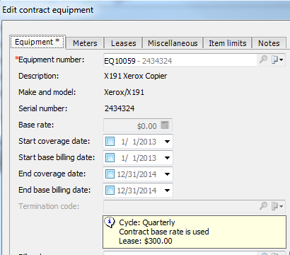
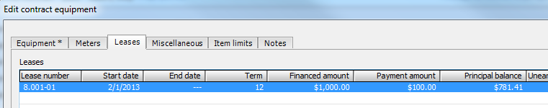
e-automate 8.5 – Lease module
Multiple leases per contract (sub-leases)

Slide 5
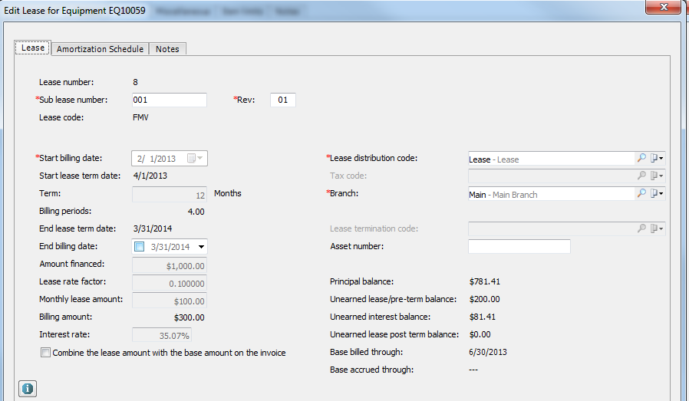
e-automate 8.5 – Lease module
Multiple leases per contract

Slide 6
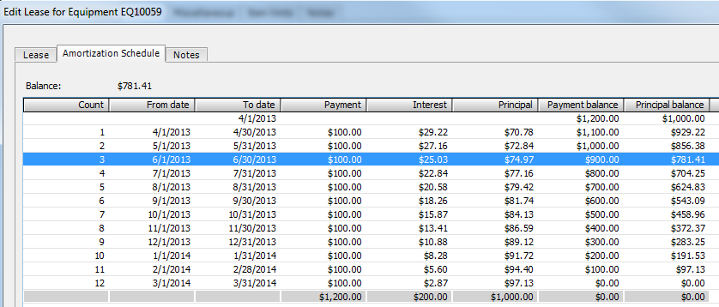
e-automate 8.5 – Lease module
Amortization schedule support

Slide 7
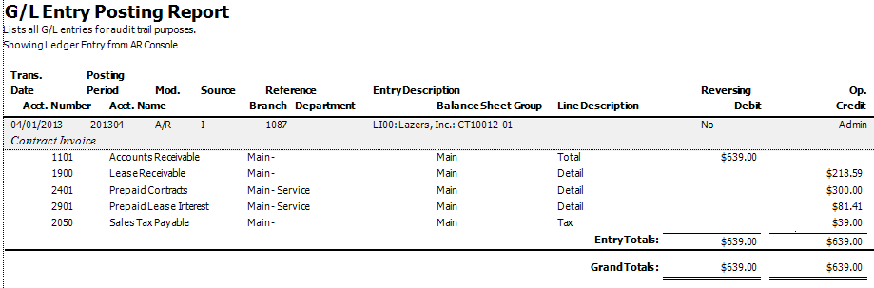
e-automate 8.5 – Lease module
Real-time interest/principal GL postings

Slide 8
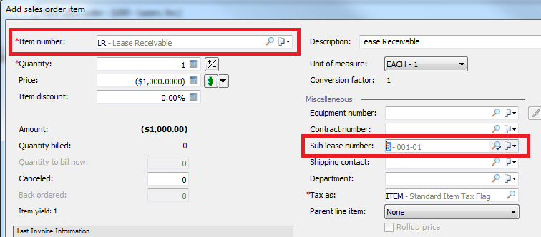
e-automate 8.5 – Lease module
Integration into sales

Slide 9
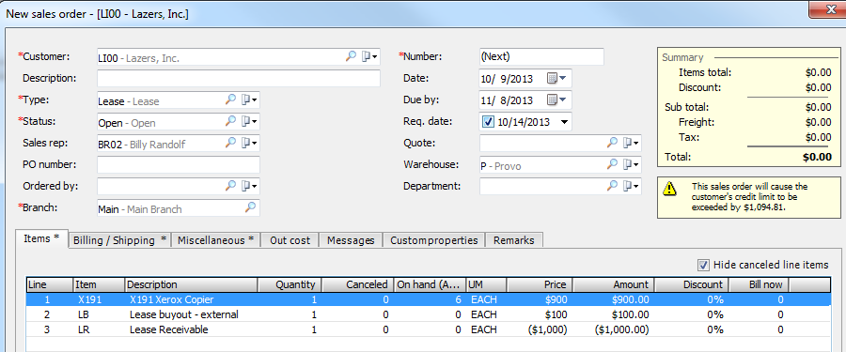
e-automate 8.5 – Lease module
Integration into sales

Slide 10
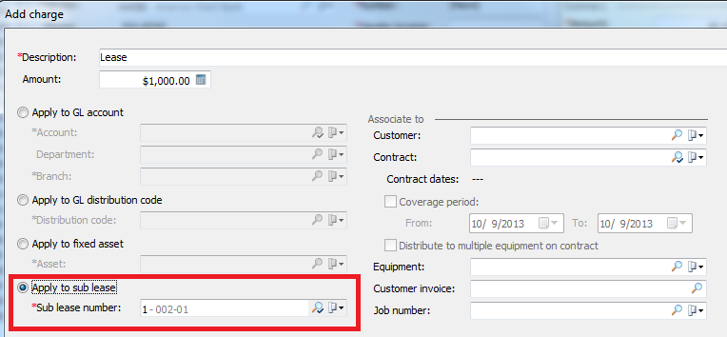
e-automate 8.5 – Lease module
Integration into vendor invoices

Slide 11
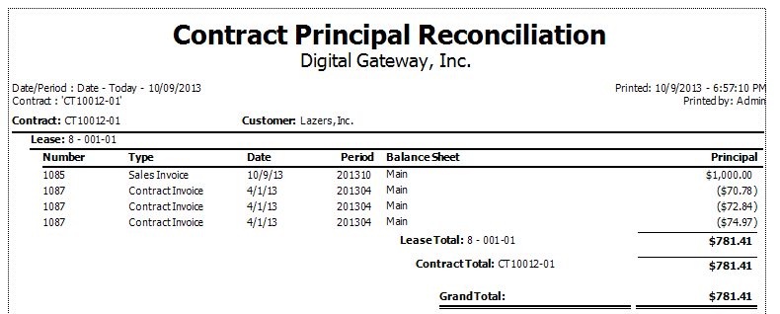
e-automate 8.5 – Lease module
Reports – Receivable/Principal Reconciliation

Slide 12
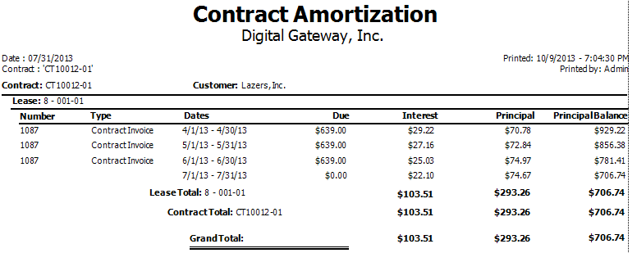
e-automate 8.5 – Lease module
Reports – Amortization schedule

Slide 13
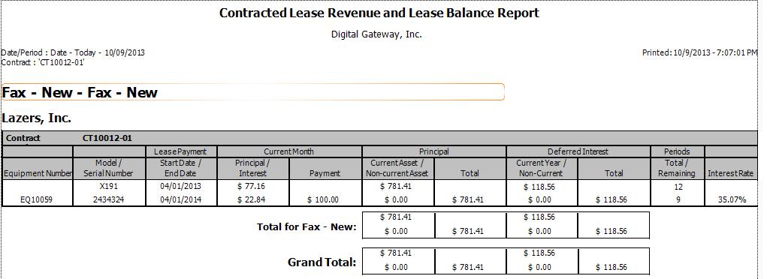
e-automate 8.5 – Lease module
Reports – Revenue and balance report

Slide 14


e-automate 8.5 – Lease module
Pre-term / term / Post-term phases
Lease-only phase (Operating or Rental)

Slide 15
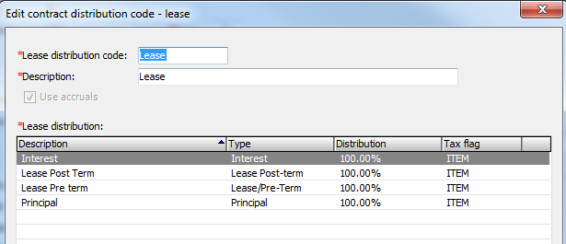
e-automate 8.5 – Lease module
Lease distribution codes

Slide 16
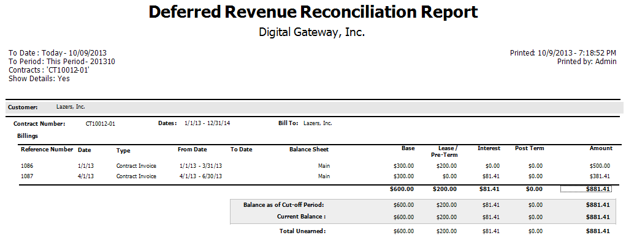
e-automate 8.5 – Lease module
Deferrals

Slide 17
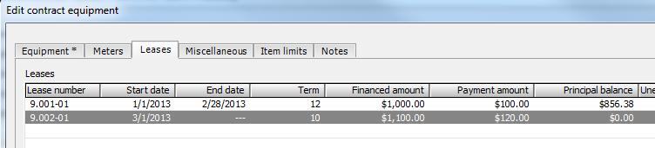
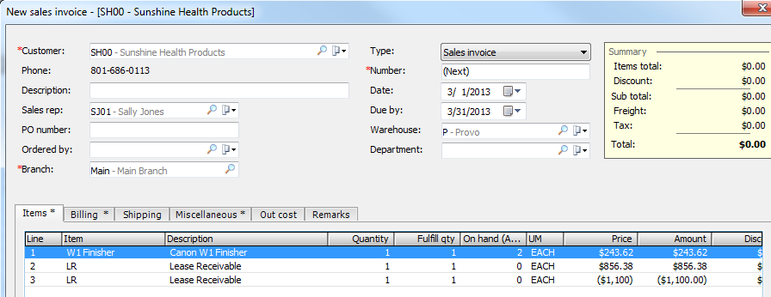
e-automate 8.5 – Lease module
Internal buyouts, additions and upgrades

Slide 18
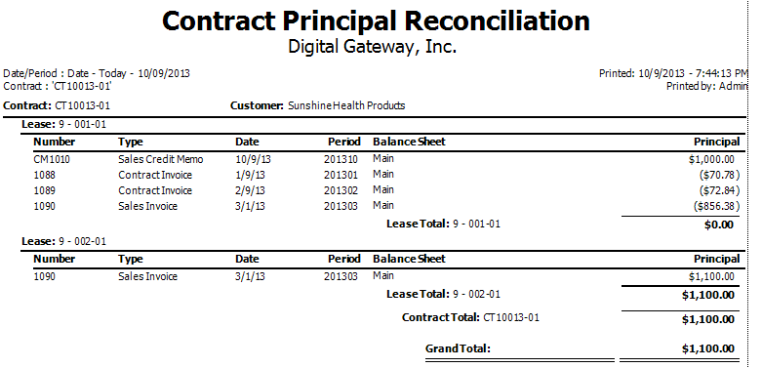
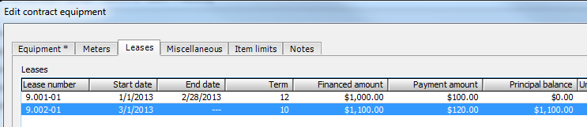
e-automate 8.5 – Lease module
Internal buyouts, additions and upgrades

Slide 19
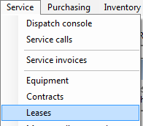
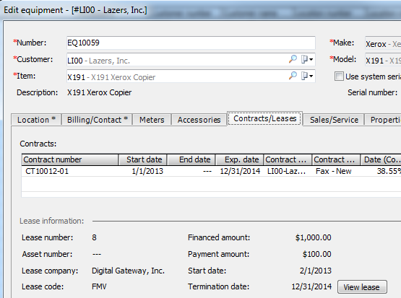
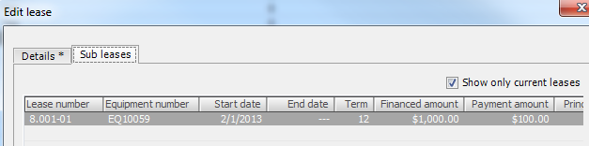
e-automate 8.5 – Lease module
Integrated into standard lease list and equipment lease tab

Slide 20
e-automate 8.5 – Budget utility
Multiple budgets
Budgets by period, account, department and branch
Create budget details from previous actuals
Excel Import and Export
Comparative budget to actual report

Slide 21
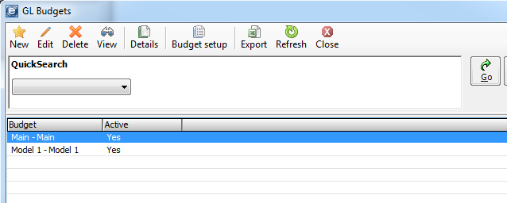
e-automate 8.1 – Budget utility
Multiple budgets

Slide 22
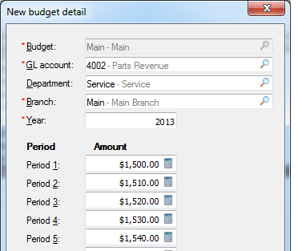
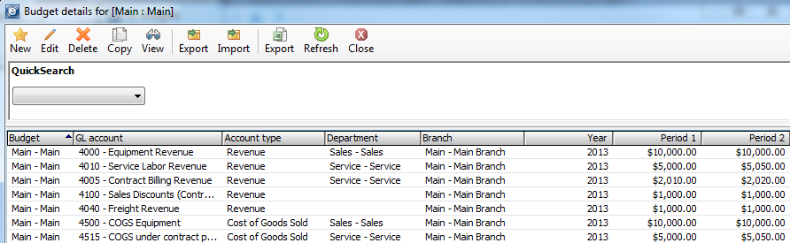
e-automate 8.1 – Budget utility
Budgets by period, account, department and branch

Slide 23
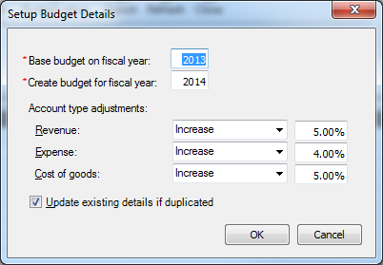
e-automate 8.1 – Budget utility
Create budget details from previous actuals

Slide 24
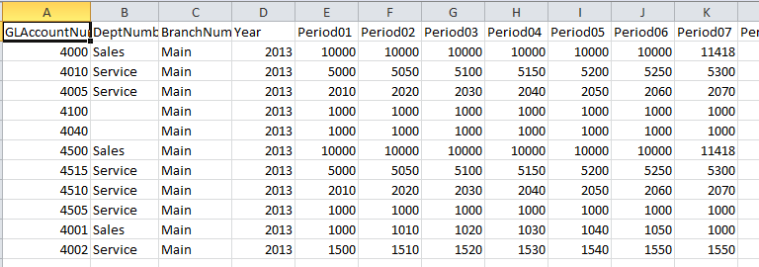
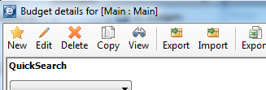
e-automate 8.1 – Budget utility
Excel Import and Export

Slide 25
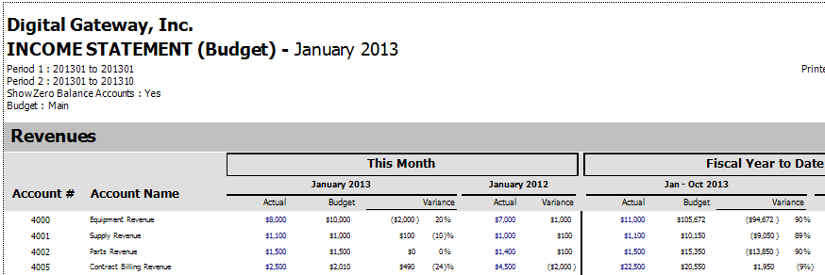
e-automate 8.1 – Budget utility
Comparative budget to actual report

Slide 26
e-automate 8.5 – Sales tax utility
Accrual or cash based
Exempt code support
Vendors on tax authorities
Calculates sales tax payables by tax authority vendor
Enhanced reports
Transacts sales tax payments

Slide 27
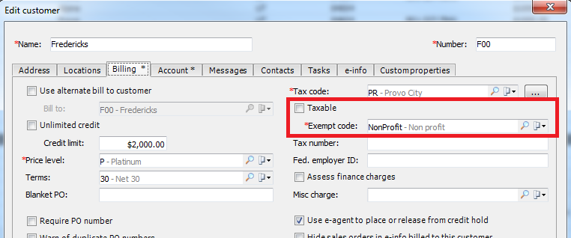
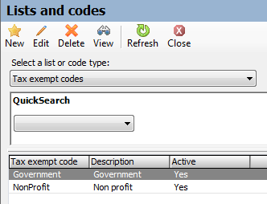
e-automate 8.1 – Sales tax utility
Exempt code support

Slide 28
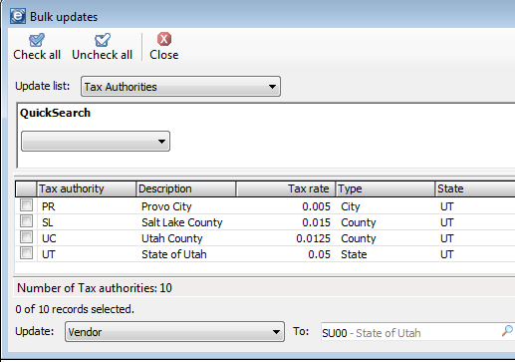
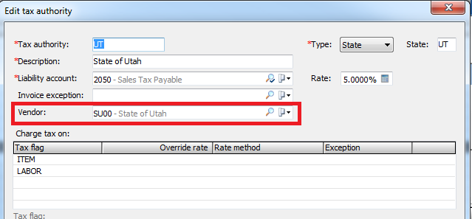
e-automate 8.1 – Sales tax utility
Vendors on tax authorities

Slide 29
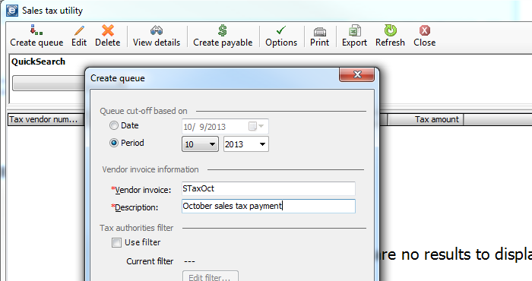
e-automate 8.1 – Sales tax utility
Calculates sales tax payables by tax authority vendor

Slide 30
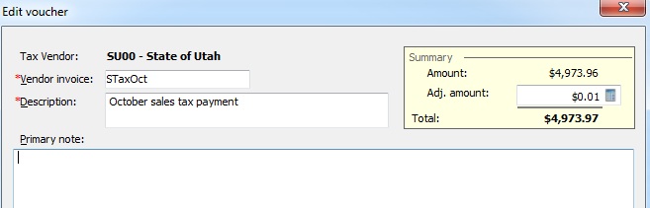
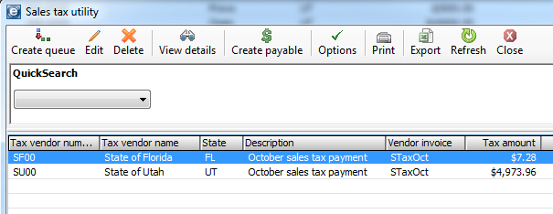
e-automate 8.1 – Sales tax utility
Calculates sales tax payables by tax authority vendor

Slide 31
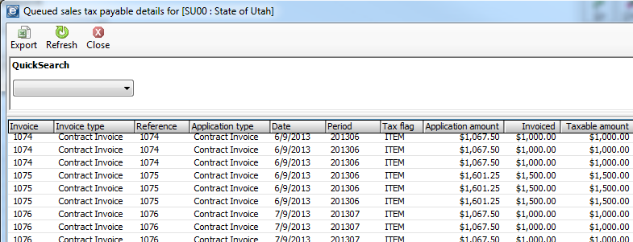
e-automate 8.1 – Sales tax utility
Calculates sales tax payables by tax authority vendor

Slide 32
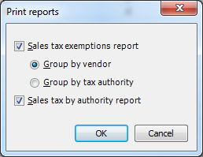
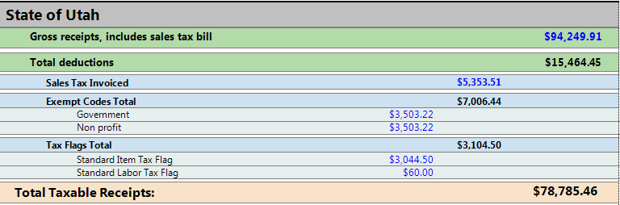
e-automate 8.1 – Sales tax utility
Enhanced reports

Slide 33
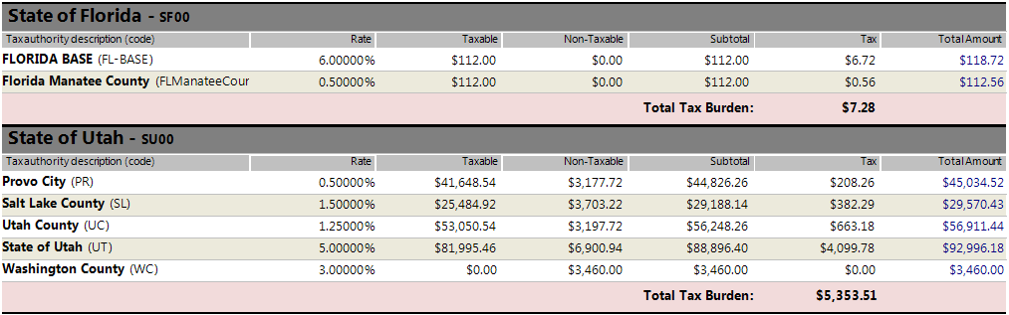
e-automate 8.1 – Sales tax utility
Enhanced reports

Slide 34
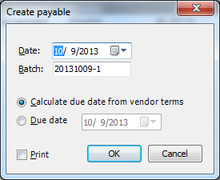
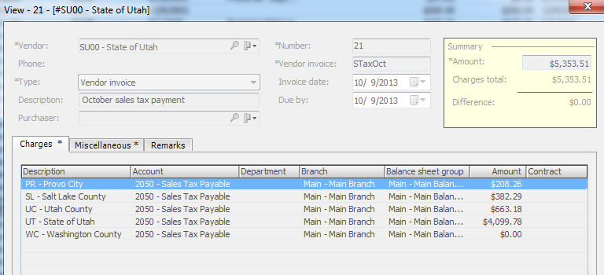
e-automate 8.1 – Sales tax utility
Transacts sales tax payments

Slide 35
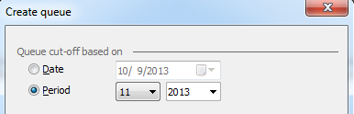
e-automate 8.1 – Sales tax utility
Reports can be run on past payments and therefore will reconcile to the past payments. Great for audits.
Removes potential of missing tax liabilities and credits

