Slide 1
e-automate development
v8.5
October 15th, 2013

Slide 2
e-automate 8.5 - overview
Anticipated release dates
Beta testing - December 2013
Limited availability – January 2014
General release – March 2014
Contains 33 total features
24 EUG features (97% of EUG commitments met)
Crystal reports upgrade
.net upgrade

Slide 3
e-automate 8.5 – Feature mix
Contracts (4)
Sales (10)
Accounting (5)
Inventory (3)
Service (5)
System (2)
Miscellaneous (4)

Slide 4
e-automate 8.5 – Contracts
*Multiple overage cycles on contracts
*Contract billing queue messaging
*Auto terminate contract e-agent task
*Contract filtering on equipment list

Slide 5
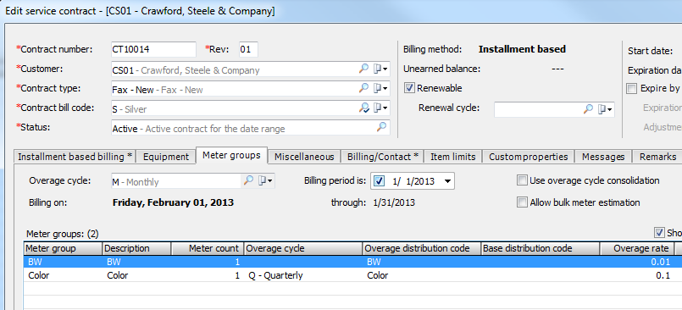
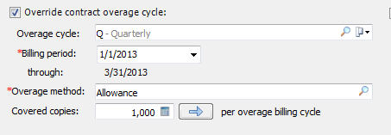
e-automate 8.5 – Contracts
*Multiple overage cycles on contracts

Slide 6
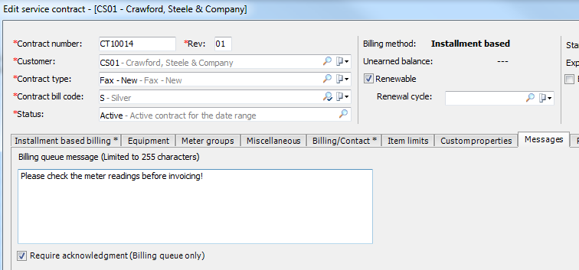
e-automate 8.5 – Contracts
*Contract billing queue messaging

Slide 7
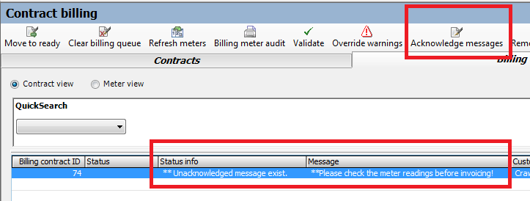
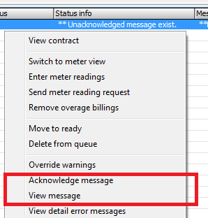
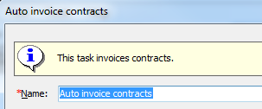
e-automate 8.5 – Contracts
*Contract billing queue messaging

Slide 8
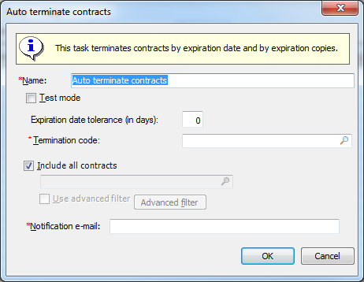
e-automate 8.5 – Contracts
*Auto terminate contract e-agent task

Slide 9
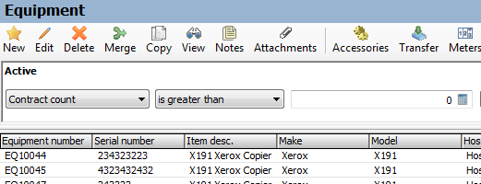
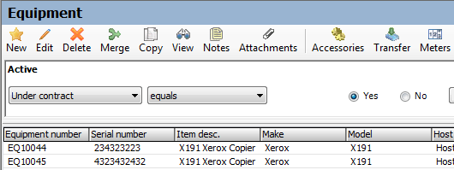
e-automate 8.5 – Contracts
*Contract filtering on equipment list

Slide 10
e-automate 8.5 – Sales
*Multiple sales orders on an invoice
*Start and end dates on item pricing
*Flag duplicate transactions on sales orders
*Improved multiple equipment support on sales orders
*Up front credit hold alert
New auto ship sales order task

Slide 11
e-automate 8.5 – Sales
*Quantity returned on sales invoices and purchase receipts
Sales invoice credit card/ach message
*Ordered by contact field on printed sales order and invoice
*Sales order list ‘Entered by’ column

Slide 12
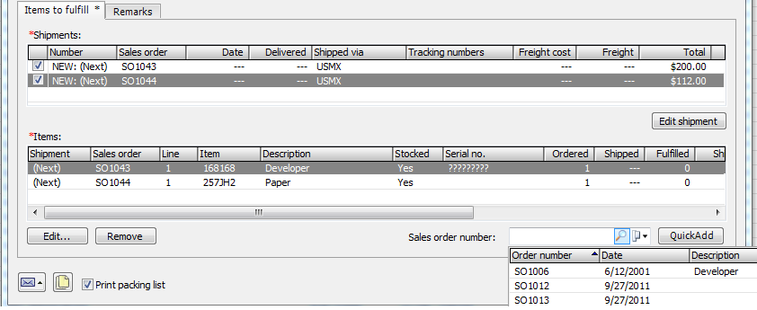
e-automate 8.5 – Sales
*Multiple sales orders on an invoice

Slide 13
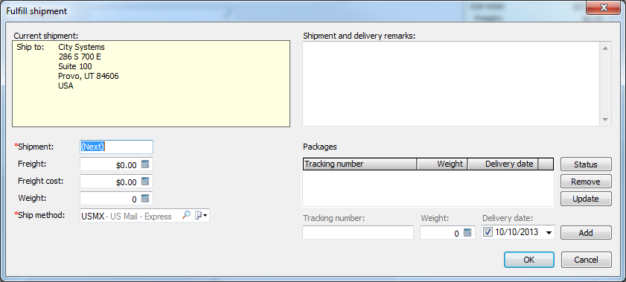
e-automate 8.5 – Sales
*Multiple sales orders on an invoice

Slide 14
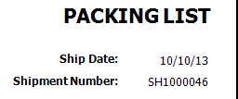
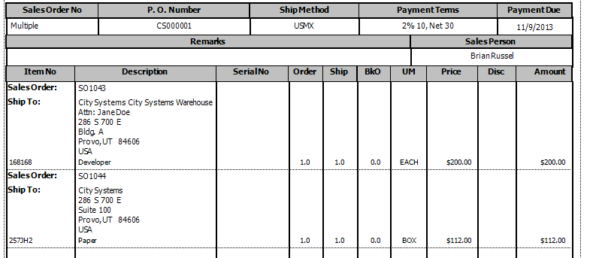
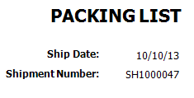
e-automate 8.5 – Sales
*Multiple sales orders on an invoice

Slide 15
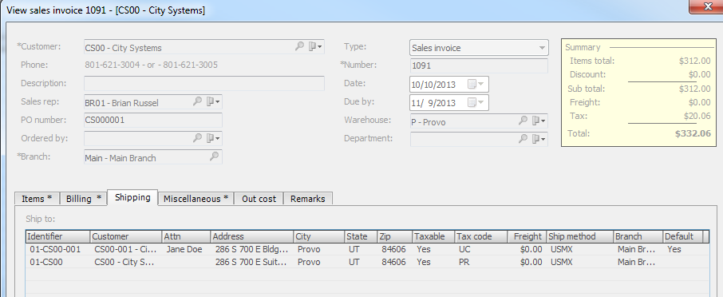
e-automate 8.5 – Sales
*Multiple sales orders on an invoice

Slide 16
e-automate 8.5 – Sales
*Start and end dates on item pricing

Slide 17
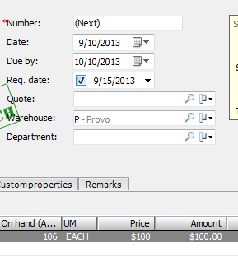
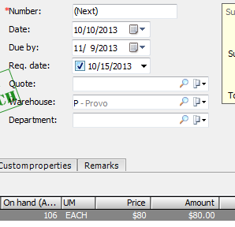
e-automate 8.5 – Sales
*Start and end dates on item pricing

Slide 18
e-automate 8.5 – Sales
*Flag duplicate transactions on sales orders

Slide 19
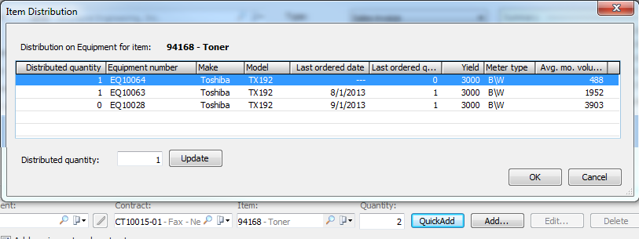
e-automate 8.5 – Sales
*Improved multiple equipment support on sales orders

Slide 20
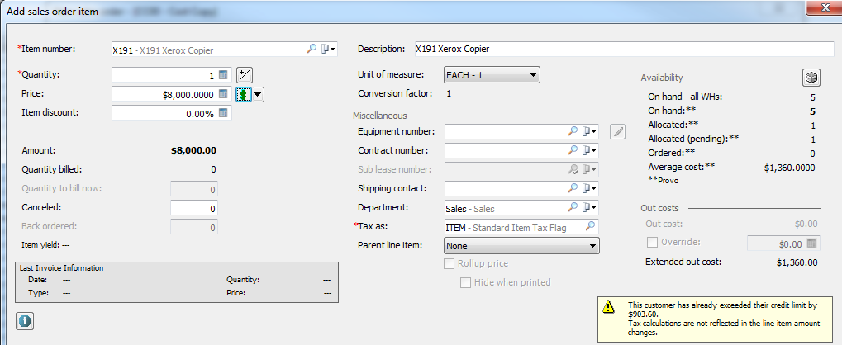
e-automate 8.5 – Sales
*Up front credit hold alert

Slide 21
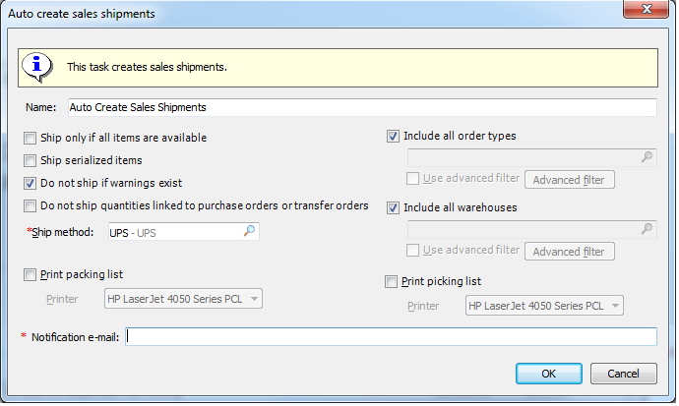
e-automate 8.5 – Sales
New auto ship sales order task

Slide 22
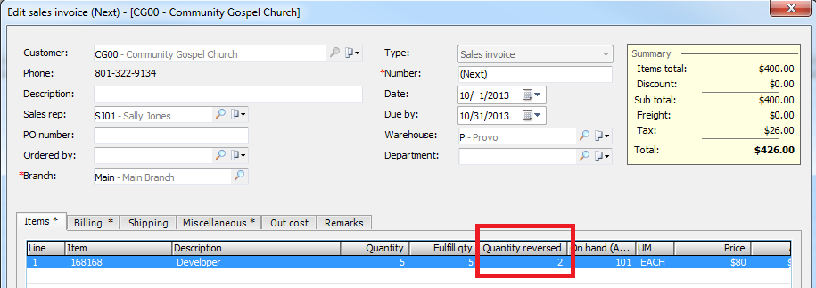
e-automate 8.5 – Sales
*Quantity returned on sales invoices and purchase receipts

Slide 23
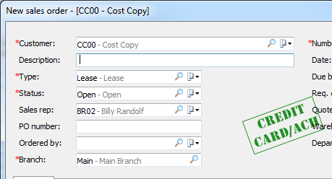
e-automate 8.5 – Sales
Sales invoice credit card/ach message

Slide 24
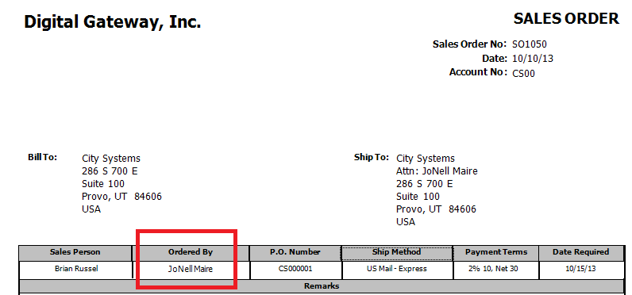
e-automate 8.5 – Sales
*Ordered by contact field on printed sales order and invoice

Slide 25
e-automate 8.5 – Sales
*Sales order list ‘Entered by’ column

Slide 26
e-automate 8.5 – Accounting
*Enhanced posting period control on edits and voids
*Customer account reports access from AR Console
Expanded PO number length on sales/service transactions
*Filter by period on business status report
*Additional vendor invoice distribution e-view columns

Slide 27
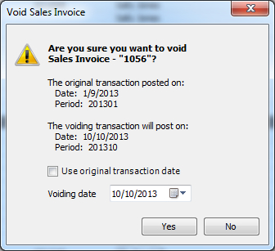
e-automate 8.5 – Accounting
*Enhanced posting period control on edits and voids

Slide 28
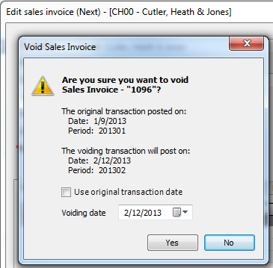
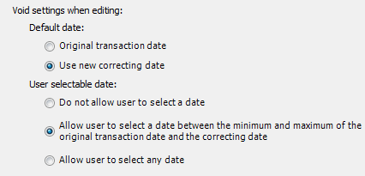
e-automate 8.5 – Accounting
*Enhanced posting period control on edits and voids

Slide 29
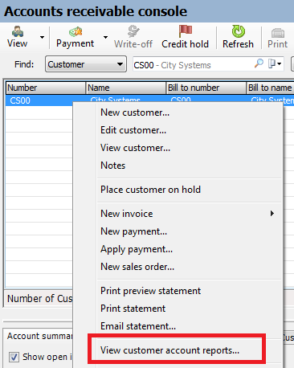
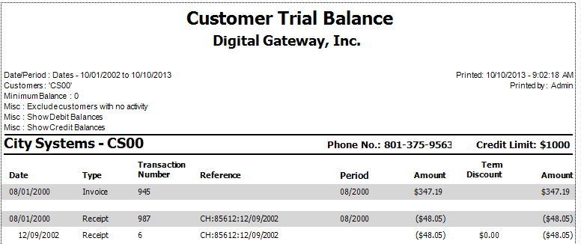
e-automate 8.5 – Accounting
*Customer account reports
access from AR Console

Slide 30
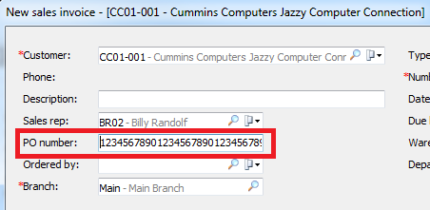
e-automate 8.5 – Accounting
Expanded PO number length on sales/service transactions

Slide 31
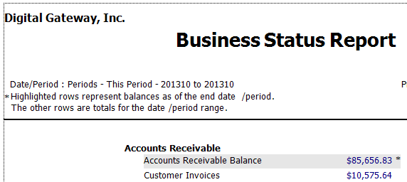
e-automate 8.5 – Accounting
*Filter by period on business status report

Slide 32
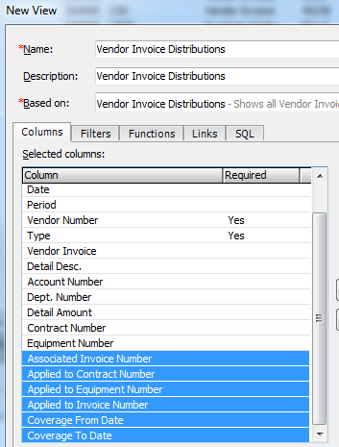
e-automate 8.5 – Accounting
*Additional vendor invoice
distribution e-view columns

Slide 33
e-automate 8.5 – Inventory
e-automate 8.5 – Inventory
*Inventory core return charges
*Bin activation restriction and messaging
*RMA warning when invoices are voided

Slide 34
e-automate 8.5 – Inventory
*Inventory core return charges

Slide 35
e-automate 8.5 – Inventory
*Bin activation restriction and messaging

Slide 36
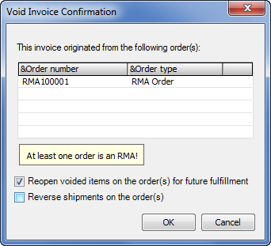
e-automate 8.5 – Inventory
*RMA warning when invoices are voided

Slide 37
e-automate 8.5 – Service
*Meter reading bypass on service calls
*Notifications when linked parts are removed from service calls
*Validate and set meters as billable from console
Aggregate labor records on service calls
*New sales rep label on service ticket report

Slide 38
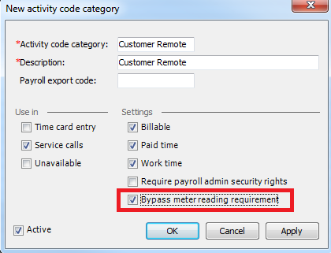
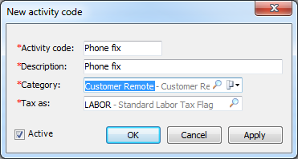
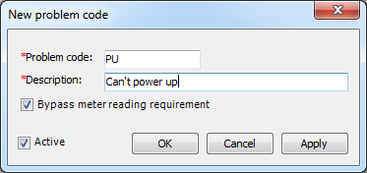
e-automate 8.5 – Service
*Meter reading bypass on service calls
Bypass if all labor is related to “bypass activity codes”
Bypass if at least one problem code is set to “bypass”

Slide 39
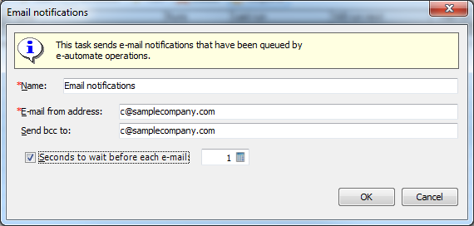
e-automate 8.5 – Service
*Notifications when linked parts are removed from service calls

Slide 40
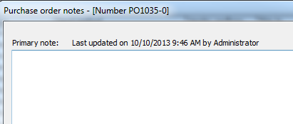
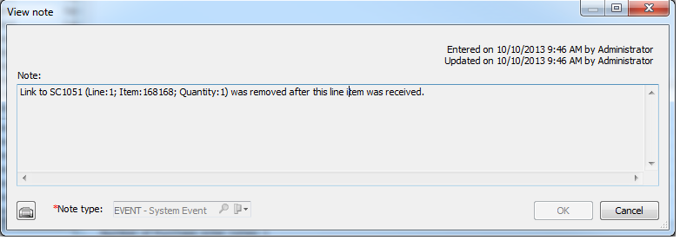
e-automate 8.5 – Service
*Notifications when linked parts are removed from service calls

Slide 41
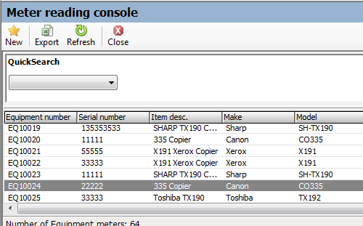
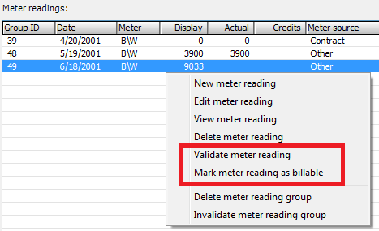
e-automate 8.5 – Service
*Validate and set meters as billable from console

Slide 42
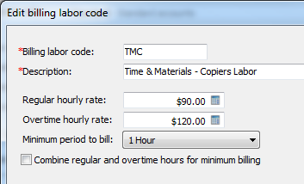
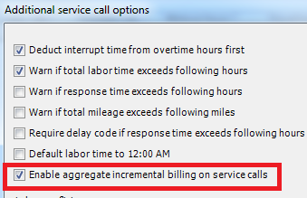
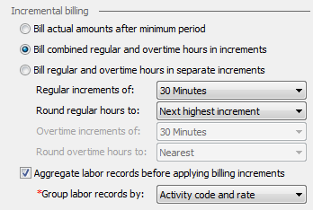
e-automate 8.5 – Service
Aggregate labor records on service calls

Slide 43
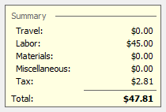
e-automate 8.5 – Service
Aggregate labor records on service calls

Slide 44
e-automate 8.5 – Service
*New sales rep label on service ticket report

Slide 45
e-automate 8.5 – System
*Field level security
Streamlined updates for e-automate clients

Slide 46
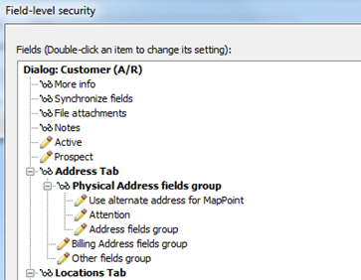
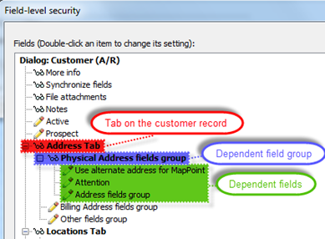
e-automate 8.5 – System
*Field level security
Customers, vendors, items, equipment, GL accounts, Cashbook accounts and branches

Slide 47
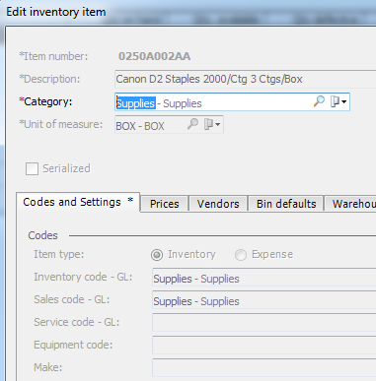
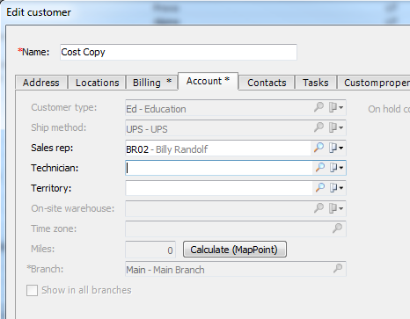
e-automate 8.5 – System
*Field level security

Slide 48
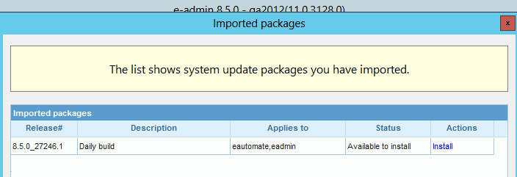
e-automate 8.5 – System
Streamlined updates for e-automate clients

Slide 49
e-automate 8.5 – Miscellaneous
*Improved messages on merges
Improved attachment access
Filtering on list and codes
E-views

Slide 50
e-automate 8.5 – Miscellaneous
*Improved messages on merges

Slide 51
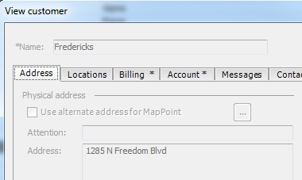
e-automate 8.5 – Miscellaneous
Improved attachment access
Access from main list and in view mode

Slide 52
e-automate 8.5 – Miscellaneous
Filtering on list and codes

Slide 53
e-automate 8.5 – Miscellaneous
E-views enhancements
Security by group
Groups are hidden if no rights
Collapsible groups

Slide 54
e-automate 8.5 – Miscellaneous
E-views enhancements
Optionally listed by category
Only see views you have rights to

Slide 55
e-automate 8.5 – Miscellaneous
E-views enhancements
User-defined tagging

